Slide 1
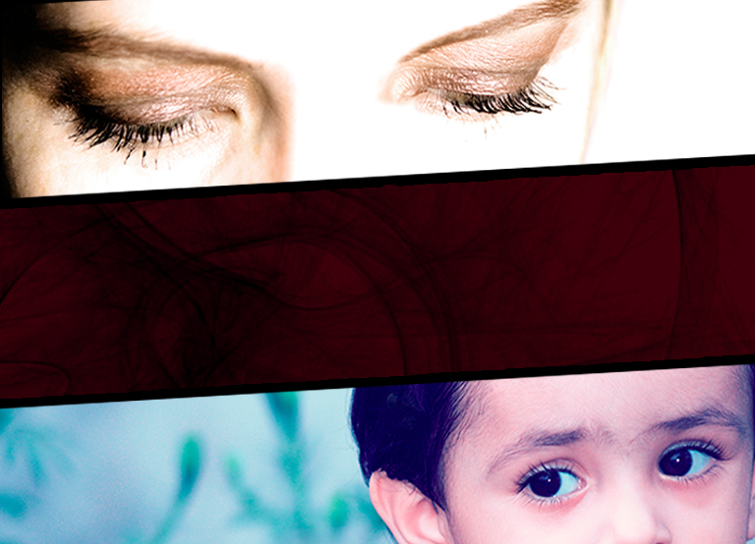
Libertad en las Relaciones
Escrito por:
Elaine Oliver, MA, CFLE and Willie Oliver, PhD, CFLE
Directores de Ministerios de la Familia
Asociación General de los Adventistas de Séptimo Día
enditnow Emphasis Day
Asociación General Departamento de Ministerios de la Mujer de la Iglesia Adventista del Séptimo Día

Slide 2
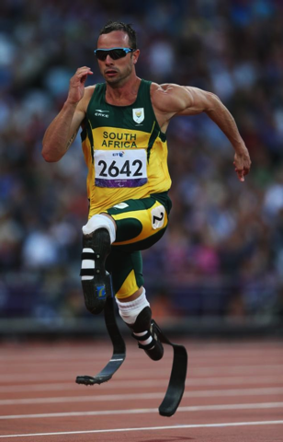
Oscar Pistorius
Quien es Oscar Pistorius?
Atleta Sudafricano.
Discapacitado, con doble amputación.
Jugador Olímpico.
Acusado de matar a su novia.
Notes:
Introduction
People around the world are closely following the media coverage of the Oscar Pistorius trial taking place in Pretoria, South Africa. Oscar Pistorius is a leading South African runner who won attention as an athlete with a disability, competing not only in the Paralympic Games but also in the 2012 Summer Olympics. In February 2013, he was charged with shooting to death his girlfriend Reeva Steenkamp. He claims he mistook her for an intruder.
As of the writing of this piece, the judge has not yet made a decision in this case, and we don’t know whether Oscar Pistorius was defending himself or had planned to kill his girlfriend. What we do know is that violence has invaded our society and there are many cases that will never make the headlines. Families are being torn apart by senseless violence right in their own homes as many people are choosing violence as the primary means of interacting with each other. The impact of these choices is incredibly far-reaching and very destructive to individuals and families.
While we may not be able to control the violence around us, the good news for Christians is that the power of God is available to all of us in unlimited supply. God’s word is filled with counsel on how to build healthy and strong relationships, especially in our families. Today, we will briefly look at the destructive nature of violence and abuse in the family, and we will review God’s original intent and perfect plan for our relationships and families.
Our sermon today is titled “Freedom in Relationships”.

Slide 3
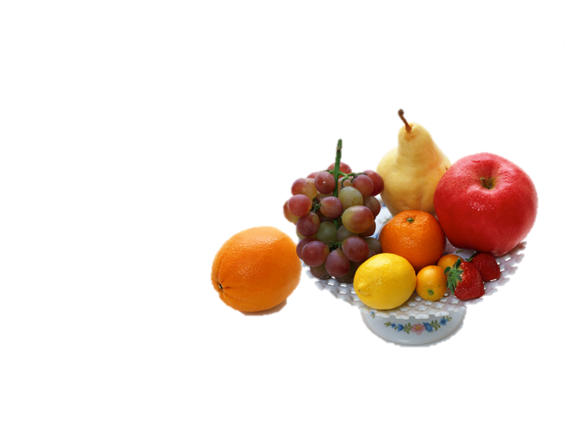
¨Pero el fruto del Espíritu es: Amor, gozo, paz, paciencia, benignidad, bondad, fidelidad, mansedumbre, dominio propio. Contra estas virtudes, no hay ley. Pero los que son de Cristo, han crucificado la carne con sus pasiones y malos deseos. Si vivimos en el Espíritu, andemos también en el Espíritu. No seamos vanagloriosos, irritándonos y envidiándonos unos a otros¨.
Gálatas 5:22-26
Notes:
A Godly Look at Relationships
In Galatians 5:22-26 (NASB) the Bible says: "But the fruit of the spirit is love, joy, peace, patience, kindness, goodness, faithfulness, gentleness, self-control; against such things there is no law. Now those who belong to Christ Jesus have crucified the flesh with its passions and desires. If we live by the Spirit, let us also walk by the Spirit. Let us not become boastful, challenging one another, envying one another.

Slide 4
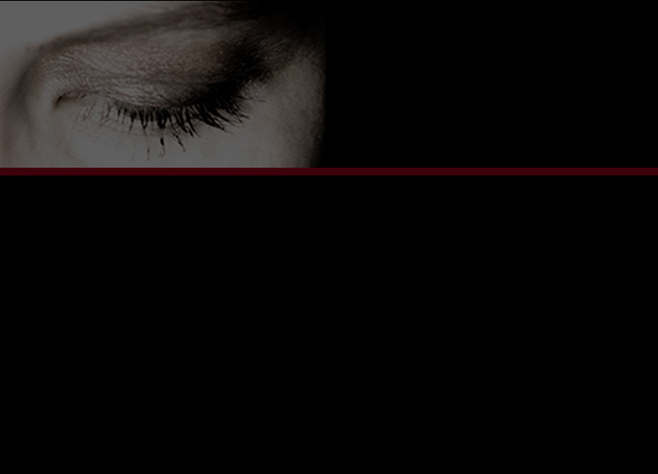
Carta de Pablo a los Gálatas
Defender su autoriad como apóstol.
El estaba parado, explicando, y provando el mensaje del evangelio.
El estaba aplicando el mensaje del evangelio a los cristianos de día a día viviendo por el poder del Espíritu Santo.
Notes:
In writing the letter to the Galatians Paul had three closely related purposes in mind:
1) He was defending his authority as an apostle because some had doubted his authenticity,
2) he was proclaiming the gospel message, and
3) he was showing that the gospel message could be applied to our daily living as Christians and that this was possible through the power of the Holy Spirit.
In this passage, Paul reminds us that after a person becomes a Christian, the need for faith in Christ does not diminish. We are to live our lives daily by faith, through the power of Jesus Christ and the Holy Spirit.
This dependence on God’s guidance is for assistance in avoiding the consequences of our behaviors as manifested by our natural sinful selves. Paul is showing that freedom in Christ is a Spirit-guided life-style “within the limits of a ‘new law’ given by Christ: the law of love.”Dockery, D. S., Butler, T. C., Church, C. L., Scott, L. L., Ellis Smith, M. A., White, J. E., & Holman Bible Publishers (Nashville, T. . (1992). Holman Bible Handbook. Nashville, TN: Holman Bible Publishers.

Slide 5
Abuso de las Escrituras y la Teología
Gálatas nos muestra cómo Dios quiere que vivan sus seguidores.
Tristemente, algunos que profesan seguir a Cristo no tienen las caracterísitcas de Cristo.
Notes:
True freedom in Christ is not about self-indulgence that leads believers to act in destructive ways toward others, but true freedom manifests itself in love towards God and love to others. However, true love doesn’t come naturally. In fact, it is against the flesh; hence, it is necessary to be guided by the Holy Spirit in our actions, attitudes, and decisions.

Slide 6
Abuso de las Escrituras y la Teología
Algunos han utilizado mal las Escrituras y la teología para justificar su conducta abusiva. El amor nunca lastima a otro!
Además, otros ayudadores bien intencionados han usado también mal la Biblia.
Notes:
Abuse of Scripture and Theology
While the basic message of the Bible is Love, when we examine the effects of abuse and violence, we see how far removed we are from God’s ideal for human relationships. There are many who profess to be Christians—disciples of Christ—but who possess none of the characteristics of Christ.
Unfortunately, in too many situations, abusers have misused scripture and theology to justify their abusive behaviors. In addition, other well-meaning helpers have also misused the Bible to convince victims to accept continued violence in their families. This misuse of scripture can be dangerous and even lethal to the victims involved

Slide 7
Nosotros (la iglesia) no debemos quedarnos Callados
La comunidad religiosa no puede permanecer más en silencio.
El silencio perpetúa la imcompresión de tales asuntos de violencia doméstica y no conduce a ningún cambio.
La iglesia puede ayudar a las familias a poner alto al abuso y puede crear ambientes más saludables.
Notes:
The religious community can no longer remain silent. This silence continues the lack of understanding of issues of domestic violence and does not lead to change. The church can help families stop abuse and can help to create healthier environments for children, teenagers and adults.
In this brief discourse today, we will get an overview of domestic violence and how it is impacting our society, including the church. We will also explore the elements of healthy, Godly relationships. The Seventh-day Adventist Church is committed to “Ending It Now,” to stopping the violence and preventing violence by equipping individuals and families with skills and insights needed to have wholesome relationships.

Slide 8
Breve resumen sobre violencia y abuso
Muchas personas son blancos de violencia y las víctimas que tocan nuestro corazón son mayormente niños. Cualquier persona puede ser víctima de la violencia. Sin embargo, las estadísticas nos imforman que las mujeres y los niños son los blancos primordiales. También los hombres son Víctimas de abuso y violencia pero en menos proporción (tal vez se deba a la falta de informes al respecto)
Notes:
Brief Overview of Violence and Abuse
We are living in an age of violence. Our senses are bombarded by violence in the news, music, television and other media outlets. Many people are the target of violence, and the victims that touch our hearts the most are the children. Anyone can be a victim of violence; however, statistics tell us that women and children are the primary targets. Men are also victims of abuse and violence, but in smaller numbers (this may be due to lack of reporting).
Regardless of who the victim is, domestic or family violence is incompatible with God’s Word.

Slide 9
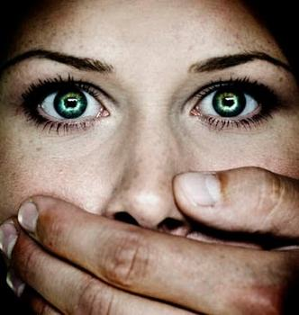
¿Que es Violencia Doméstica?
Abuso físico.
Abuso sexual.
Abuso emocional: incluye comportamientos que degradan o hacen menos a las personas.
Notes:
What is Domestic Violence?
Let’s first look at some definitions and general information about domestic violence. Domestic violence includes physical abuse, sexual abuse, and emotional abuse. To be sure, there is not hierarchy of abuse; each one is equally destructive.
Physical abuse may be include behaviors such as pushing and kicking and can escalate into more injurious attacks. It can start with minor bruising but could end in murder.
Sexual abuse can include inappropriate touching and verbal remarks. Rape, molestation and incest are also included in this category.
Emotional abuse includes behaviors that consistently degrade or belittle the individual. It can include verbal threats, episodes of rage, obscene language, demands for perfection, and invalidation of character and person. Extreme possessiveness, isolation, and depriving someone of economic resources are all psychologically and emotionally abusive.

Slide 10
Las Víctimas
1 de 4 mujeres experimentaran violencia doméstica.
Hay más probabilidades que las mujeres sean asesinadas por su pareja, que los hombres sean.
Las mujeres entra la edad de 20 – 24 tienen mas riesgo de ser víctimas de violencia doméstica.
Cada año, 1 de 3 mujeres víctima de homicidio, son asesinadas por su pareja.
Notes:
General Facts about Domestic Violence:
There is no one profile of abusers or victims. Both may come from all age groups, ethnic groups, socio-economic classes, professions, and religious or non-religious communities. Abuse and violence may take several forms: physical, sexual, or emotional. In the case of the elderly and children it may also include severe neglect. [The following statistics are primarily for the US. Presenters should research stats from their own territory to be most relevant]
The Victims:
1 in 4 women will experience domestic violence, also known as intimate partner violence, during her lifetime.
Women are more likely than men to be killed by an intimate partner.
Women between the ages of 20-24 are at the greatest risk of becoming victims of domestic violence.
Every year, 1 in 3 female homicide victims is murdered by her current or former partner. National Coalition Against Domestic Violence (NCADV) factsheet. Domestic Violence Facts.

Slide 11
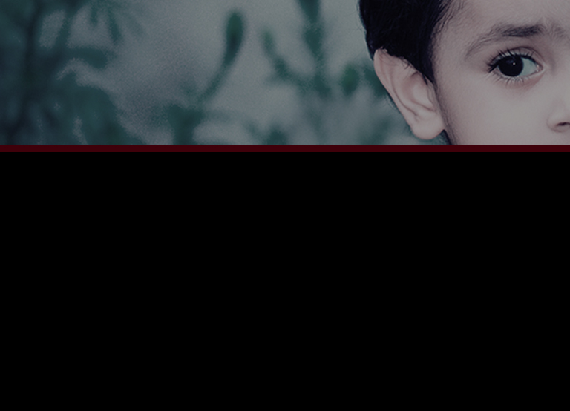
Las Familias
Cada año, más de 3 millones de niños son testigos de violencia doméstica en su hogar.
30 a 70% de los niños que viven en hogares donde hay violencia doméstica sufren también de abuso o negligencia.
Notes:
The Families:
Every year, more than 3 million children witness domestic violence in their homes.
Thirty to sixty percent of children who live in homes where there is domestic violence also suffer abuse or neglect.

Slide 12
Las familias
Un estudio reciente encontró que los niños expuestos a violencia doméstica en su hogar tienen más probabilidades de tener problemas de salud, incluyendo el enfermarse más frecuentemente, tener dolor de cabeza o de estómago con más frecuencia y sentirse más cansados y letárgicos.
Notes:
A recent study found that children exposed to domestic violence at home are more likely to have health problems, including becoming sick more often, having frequent headaches or stomachaches, and being more tired and lethargic.

Slide 13
Las Familias
Otro estudio encontró que los niños tienen más probabilidades de intervenir cuando son testigos de violencia severa contra uno de los padres. Esto coloca al niño en situación de gran riesgo de ser lastimado e incluso morir.
Notes:
Another study found that children are more likely to intervene when they witness severe violence against a parent. This can place a child at great risk for injury or even death.

Slide 14
Las consecuencias
Los sobrevivientes de violencia doméstica enfrentan altos niveles de depresión, disturbios de sueño y otras angustias emocionales.
La violencia doméstica contribuye a la mala salud de muchos sobrevivientes.
Notes:
The Consequences:
Survivors of domestic violence face high rates of depression, sleep disturbances, and other emotional distress.
Domestic violence contributes to poor health for many survivors.

Slide 15
Las Consecuencias
Sin ayuda, las niñas que son testigos de violencia doméstica son más vulnerables al abuso en su adolescencia y vida adulta.
Sin ayuda, los niños que son testigos de violencia doméstica tienen muchas más probabilidades de convertirse en su edad adulta, en abusadores de su pareja y niños, continuando así el ciclo de violencia en la siguiente generación.
Notes:
Without help, girls who witness domestic violence are more vulnerable to abuse as teens and adults.
Without help, boys who witness domestic violence are far more likely to become abusers of their partners and/or children as adults, thus continuing the cycle of violence in the next generation.

Slide 16
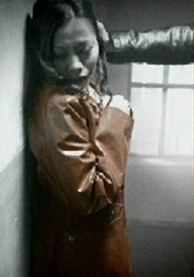
Los hechos más importantes
La mayoría de los incidentes de violencia doméstica NUNCA se informan.
Las víctimas raramente mienten. Los expertos están de acuerdo en que los niños no pueden generalmente describir experiencias que nunca han tenido. Debemos escuchar y responder apropiadamente.
Notes:
More Important Facts:
Most incidents of domestic violence are NEVER reported.
Victims rarely lie. Experts agree that children ordinarily cannot describe experiences they have never had. We must listen and respond appropriately. Faith Trust Institute, FAQs about child abuse. www.faithtrustinstitute.org.

Slide 17
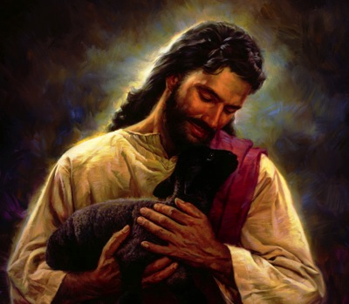
Dios es un Dios relacional
Los seres humanos son creados por un Dios Trino relacional.
La trinidad. Dios, quien es Uno pero compuesto por tres distintas personas:
Padre
Hijo
Espíritu Santo
Notes:
A Model for Godly Relationships
These facts are not pleasant and remind us of the brokenness of the world we live in. The wonderful news is that God has not left us alone. Scripture presents the true picture of how human relationships should look. Human beings are created by a relational Triune God—The Trinity, God, being one, yet composed of three distinct persons, Father, Son, and Holy Spirit.

Slide 18
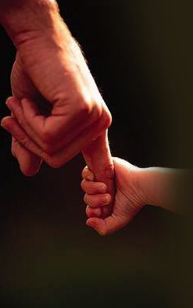
Nuestro Dios relacional nos creó entonces para entrar en relaciones significativas y gratificantes, que reflejan lo relacional dentro de la Santa Trinidad.
Notes:
Our relational God then created us to be in significant and fulfilling relationships. Hence, our relationships are to reflect the relationality within the Holy Trinity. In essence, God intends for all our relationships to be a reflection of Him!
We must of course acknowledge that unlike God, we are not perfect and because of these imperfections we will struggle in applying biblical principles to our relationships. We must seek God’s guidance for grace and strength to attain true freedom in our relationships.

Slide 19
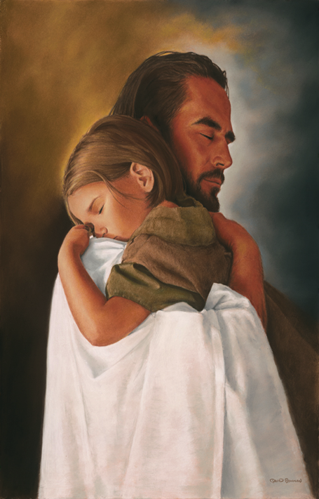
4 Elementos básicos para las relaciones Saludables
Pacto
Gracia
Habilitación
Intimidad
Notes:
As we study the Old and New Testaments, we can identify four basic elements that are essential to healthy relationships and will bring true freedom in our relationships.
These elements are covenant, grace, empowerment, and intimacy. Balswick, Jack O & Judith K. Balswick. 2014. 4th Edition. The Family: A Christian Perspective on the Contemporary Home. Grand Rapids, MI: Baker Book House.

Slide 20
PACTO
Primera mención en la Biblia de un pacto, se encuentra en Génesis 6:18 cuando Dios hace un pacto con Noé.
Segunda referencia bíblica en la que Dios hace un pacto se encuentra en Génesis 15:18, en donde se le extiende un pacto a Abrahán.
Dios demuestra inequívocamente que un pacto verdadero tiene que ver con amar y ser amado.
Notes:
Covenant: The first element that brings freedom in relationships is covenant.
The first biblical mention of a covenant is found in Genesis 6:18, in which God makes a covenant with Noah. The second biblical reference in which God makes a covenant is found in Genesis 15:18, where a covenant is extended to Abraham, and subsequently amplified in Genesis 17:1-7. God’s covenant with Abraham, which God later ratifies with Israel, is an eternal covenant. God demonstrates unequivocally that a true covenant is about loving and being loved.

Slide 21
La palabra Pacto viene del hebreo berth, que significa “acuerdo” o “arreglo”; y del griego diatheke, que significa “ultimo testamento, decreto o cuardo” (Horn 1979, p. 243)
Notes:
The word covenant comes from the Hebrew berth, which means “agreement” or “arrangement”; and from the Greek diatheke, which means “last will and testament, decree or agreement” (Horn 1979, p. 243). Horn, Siegfried H, ed. 1979. Seventh-day Adventist Bible Dictionary. Hagerstown, MD: Review and Herald Publishing Association.

Slide 22
En la Biblia, la palabra pacto se usa para describir el matrimonio, el acuerdo más serio y trascendental conocido en las Escrituras (Malaquías 2:14; Proverbios 2:16,17). La intención de Dios es que la relación entre esposo y esposa siga el modelo de su pacto infinito con su pueblo.
Notes:
In the Bible, covenant is the word used to describe marriage, the most serious and compelling agreement known in the Scriptures (Malachi 2:14; Proverbs 2:16, 17). It is God’s intent that the relationship between husband and wife be modeled after His endless covenant with His people.
Covenant relationships can either be a one-way commitment or a two-way commitment. A one-way unconditional relationship is an initial covenant in human relations, and a two-way unconditional relationship is a mature or growing covenant. This is true not only of the marriage relation but of other family relations as well, and of meaningful relationships of any kind.
An excellent example of a two-way covenant is the story of Ruth and Boaz. He showed unconditional commitment to her and respect for her in spite of the fact that he wasn't required to be kind to her. Of course, the ultimate covenant relationship is God's unconditional love for us despite our unfaithfulness.
Contrary to popular belief, marriage is not a 50/50 proposition. The covenant relationship in marriage is a 100/100 proposition. It is based on unconditional commitment to an individual based on our decision to love them, and not on that individual’s response to our love. Paul, the apostle, in 1 Corinthians 13:5 states categorically, “Love keeps no record of wrongs.”
When there is abuse in the family, this suggests a one-way and immature covenant, and must move into a two-way mode in order for the relationship to survive. Indeed, when there is abuse between spouses it destroys the covenant God wants us to develop in marriage.

Slide 23
En las amistades cercanas, en el matrimonio y en la posición de padres, Dios nos da oportunidades para entender mejor su amor por nosotros y el plan de salvación. Y es especialmente una parte del plan de Dios para la relación del matrimonio y entre padres e hijos, el avanzar hacia pactos incondicionales de dos vías.
Notes:
In close friendships, in marriage, and in parenting, God gives us opportunities to better understand His love for us, and the plan of salvation. And it is especially a part of God’s plan for the marriage relationship and the parent/child relationship to develop into unconditional two-way commitments.

Slide 24
GRACIA
¿Qué es la Gracia?
Dios desea que entendamos que la gracia tiene que ver con perdonar y ser perdonados. (Mateo 6:15)
Las relaciones familiares, como fueron diseñadas por Dios, deben vivirse en un ambiente de gracia, no de ley!
Notes:
2. Grace: The second element that brings freedom in relationships is grace. God wants us to understand that grace is about forgiving and being forgiven--Matthew 6:15.
Family relations as designed by God are meant to be lived out in an atmosphere of grace, not law. Family life based upon contract leads to an atmosphere of law, while family life based upon covenant leads to an atmosphere of grace and forgiveness. In an atmosphere of grace, family members act responsibly out of love and consideration for one another. In a family based on law, perfection will be demanded of each other.
This approach to relating, adds guilt to the failure that is inevitable because of our fallen and broken human condition (Romans 3:23-24). Let’s face the reality of life; we are all going to make mistakes in our relationships. There is no humanly possible way of getting around this fact, though many may be in denial of its existence.
Unfortunately, because of the legalism that often accompanies a fundamentalist approach to faith and religion, despite the grace-filled life of Jesus Christ and the message found in the parables He shared, we often fail to offer grace to one another in relationships.
David Seamands, a Christian counselor, suggests that the two main causes of most emotional problems among Christians are: 1) the failure to understand, receive, and live out God’s unconditional grace and forgiveness; and 2) failure to give out that unconditional love, forgiveness, and grace to other people. The good news of the Gospel has not really been understood in our lives so we fail to forgive one another as we fail to forgive ourselves for faults we are bound to make while traveling the road of discipleship. The disciple is not perfect, simply forgiven. Seamands, David. April 10, 1981. “Perfectionism: Fraught with Fruits of Self-Destruction,” in Christianity Today.

Slide 25
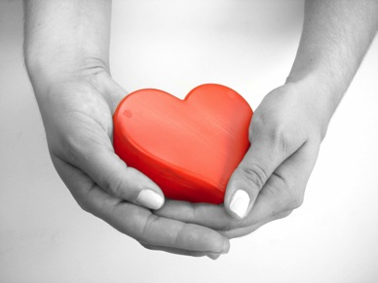
“El amor imparte a su poseedor gracia, propiedad y dignidad de comportamiento. Ilumina el rostro y suaviza la voz; refina y eleva todo el ser”. (OE 129)
Notes:
Ellen White tells us in Gospel Workers, “Love imparts to its possessor grace, propriety, and comeliness of deportment. It illuminates the countenance and subdues the voice; it refines and elevates the entire being.” (White 1915, p. 123)
We offer grace and forgiveness to those we have decided to love and have determined to be in relationship with, because tomorrow, we are the ones who will need to be the recipients of that grace. White, Ellen. 1915. Gospel Workers. Washington, D.C.: Review and Herald Publishing Association.

Slide 26
En las amistades cercanas, en el matrimonio y en la posición de padres, Dios nos da oportunidades para entender mejor su amor por nosotros y el plan de salvación. Y es especialmente una parte del plan de Dios para la relación del matrimonio y entre padres e hijos, el avanzar hacia pactos incondicionales de dos vías.
Notes:
Because of God’s grace, whether or not we are ready to believe this verified truism, there isn’t anything we can do to make Him love us more; but more importantly, make no mistake, there isn’t anything we can do to make Him love us less. And yet, when we love God, it is His grace that gives us the power to obey Him, and when we obey God, our lives are lived to overflowing. Brothers and sisters, ladies and gentlemen, it is this grace that will give our relationships the peace and security we each need to find freedom in relationship.

Slide 27
HABILITACION
Habilitación o empoderamiento es un concepto bíblico que tiene que ver con el uso del poder, el cual, sin exepción, es contrario al uso común del poder en la familia y la sociedad. Es el proceso activo e intencional de habilitar a otra persona para que adquiera poder. La persona empoderada ha obtenido poder a través de la cunducta alentadora de otra.
(1 Corintios 13:4-6)
Notes:
3. Empowerment: The third element that brings freedom in relationships is the notion of empowerment. God wants us to know, definitively, that life is about service. That is, serving one another.
Empowerment is a biblical concept for the use of power, which, without exception, is contrary to the common use of power in our families and our society. It is the active, intentional process of enabling another person to acquire power. The person who is empowered has gained power because of the encouraging behavior of the other (1 Corinthians 13:4-6).
Empowerment is the process of helping another person recognize their strengths and potential, as well as encouraging and guiding the development of these qualities. When we empower people, we in turn are empowered, and our relationship is enhanced.
Empowerment is love in action. This is the characteristic of Jesus Christ that our family members must emulate most. If we are able to practice empowerment in our families, it will revolutionize the view of authority in Christian homes. Coercion and manipulation are the opposite of empowerment. They are a distortion of what true power is. Empowerment is about mutuality and unity.

Slide 28
INTIMIDAD
Intimidad significa conocer a alquien y ser conocido por esa persona en una relación de pacto.
Notes:
4. Intimacy: The fourth and final element that brings freedom in relationships is intimacy. Intimacy means knowing someone and being known by that person in a covenant relationship.
Human beings have the capacity, given them by God, to know each other intimately. The intimacy that Adam and Eve felt was the ability to be themselves without any pretense. They had no need to play deceptive games with one another because they had respect for one another and didn’t abuse one another (Genesis 2:25).
Shame is born out of fear of being known intimately. Where shame is present, family members put on masks and begin to play deceptive roles for each other. By contrast, as we examine how Genesis describes the nature of the prefall human family, we find an emphasis on intimacy, on the knowing of the other.
Many people are afraid to enter into relationships for the fear of being rejected by another. Intimacy eludes them because they never truly allow themselves to be known by the person they claim to be in a relationship with. Because they never share their true feelings, there is no basis for a real relationship, and they grope in relationship darkness--hampered, handicapped, and hindered, by their own lack of self-disclosure.

Slide 29
EN EL AMOR NO HAY MIEDO!
“En el amor no hay temor. Antes el amor perfecto echa fuera el temor” .
(1 Juan 4:18)
Notes:
For family members to be able to communicate feelings freely and openly with each other, there must be trust and commitment. The Bible tells us in 1 John 4:18, “There is no fear in love. But perfect love drives out fear.”
Members of a family that is based on covenant love, and who live in an atmosphere of grace and empowering one another, will be able to so communicate and express themselves that they intimately know and are known by one another.
The unconditional love modeled by Jesus gives us a picture of the type of communicative intimacy desirable in family relationships and any other significant relationships. Forgiving and being forgiven will be an important part of renewal. There will be a need to confess as well as to receive confession. This is a two-way street that can clear out the unfinished issues between family members. In intimacy, there is no need to be ashamed to admit failure and ask for forgiveness and reconciliation. In fact, it is only when we take the steps to understand what Jesus did for us and continues to do for us each day that we can get to the point of being able to achieve intimacy with another individual and find satisfaction in relationships.
Conclusion
Many today find themselves outside of this model of healthy family relationships. In homes where abuse has not infiltrated, we encourage you starting today to strive towards this model through the power of the Holy Spirit as promised to each and every one of us. In homes where abuse has already made its ugly and destructive visit, we implore you to recognize the abuse, and to seek counsel and professional help as soon as possible and begin the healing.
To have freedom in relationships, we need to have a covenant relationship; we need to have relationships filled with grace (forgiveness), with empowerment and intimacy. Only with Jesus Christ is this possible. We invite you to accept Him anew into your hearts today.

